Slide 1
How IT change education and science Oleksandr Krakovetskyi CEO, DevRain Solutions @msugvnua, alex.krakovetskiy@devrain.com

Slide 2
About
CEO of DevRain Solutions – software development.
Microsoft Regional Director.
Microsoft Windows Phone Most Valuable Professional (Windows Platform Development).
Best Professional in Software Architecture (Ukrainian IT Award).
Ph.D. in Computer Science.
Speaker and blogger.

Slide 3

Knowledge, not diploma
Ernst & Young Removes Degree Classification From Entry Criteria As There’s ‘No Evidence’ University Equals Success
http://www.huffingtonpost.co.uk/2016/01/07/ernst-and-young-removes-degree-classification-entry-criteria_n_7932590.html

Slide 4
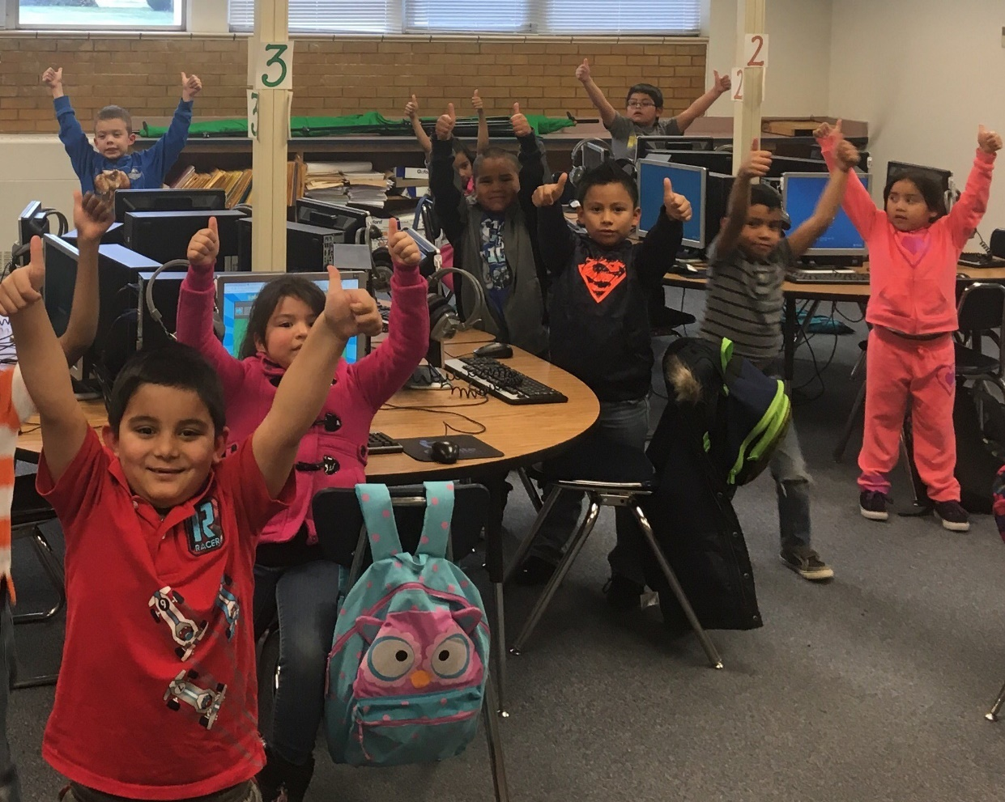
#hourofcode
The Hour of Code is a global movement reaching tens of millions of students in 180+ countries. Anyone, anywhere can organize an Hour of Code event. One-hour tutorials are available in over 45 languages. No experience needed. Ages 4 to 104.
148,997 Hour of Code events around the world, 682 in Ukraine
https://code.org/
https://hourofcode.com/ua
https://hourofcode.com/ua/en/events/all/ua
https://www.youtube.com/watch?v=2DxWIxec6yo

Slide 5
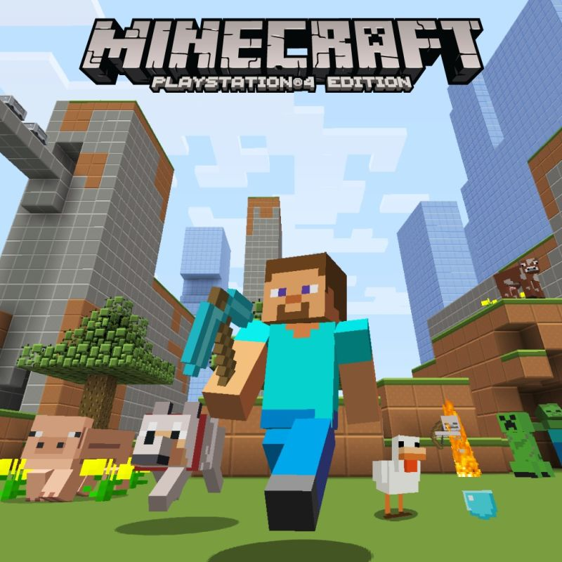
Minecraft Education
Minecraft: Education Edition is an open-world game that promotes creativity, collaboration, and problem-solving in an immersive environment where the only limit is your imagination.
https://education.minecraft.net/
Minecraft: The Story of Mojang https://www.youtube.com/watch?v=ySRgVo1X_18
https://www.youtube.com/watch?v=4KDtsJgiFEI
http://www.edutainme.ru/post/minecraft-v-obrazovanii/

Slide 6

Virtual/Hybrid Courses
Udemy
Edex
TED
Coursera
iTunes U
Pluralsight
Microsoft Virtual Academy
Prometheus

Slide 7
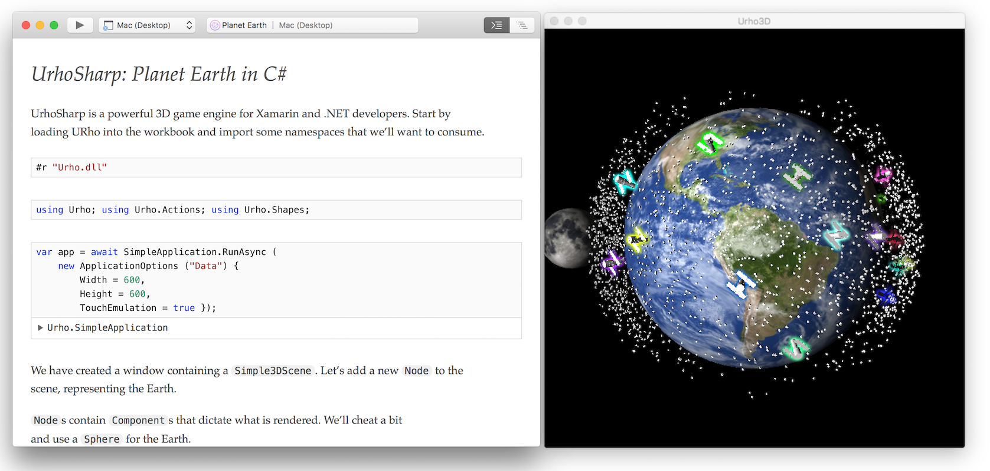
Xamarin Workbooks
Xamarin Workbooks provide a blend of documentation and code that is perfect for experimentation, learning, and creating guides and teaching aids. Create a rich C# workbook for Android, iOS, Mac, WPF, or Console, and get instant live results as you learn these APIs.

Slide 8
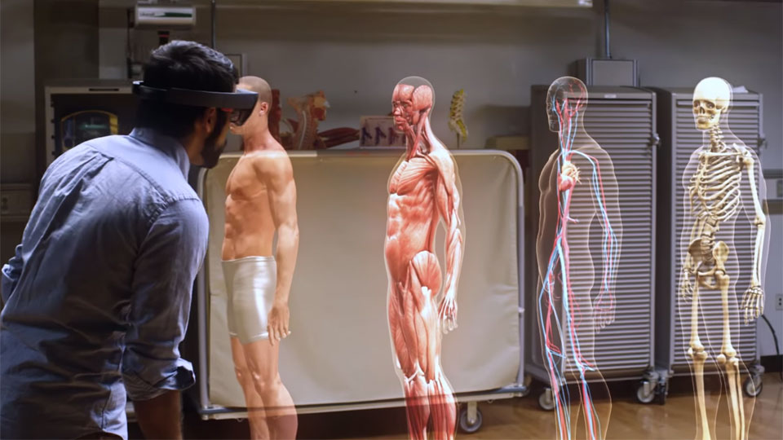
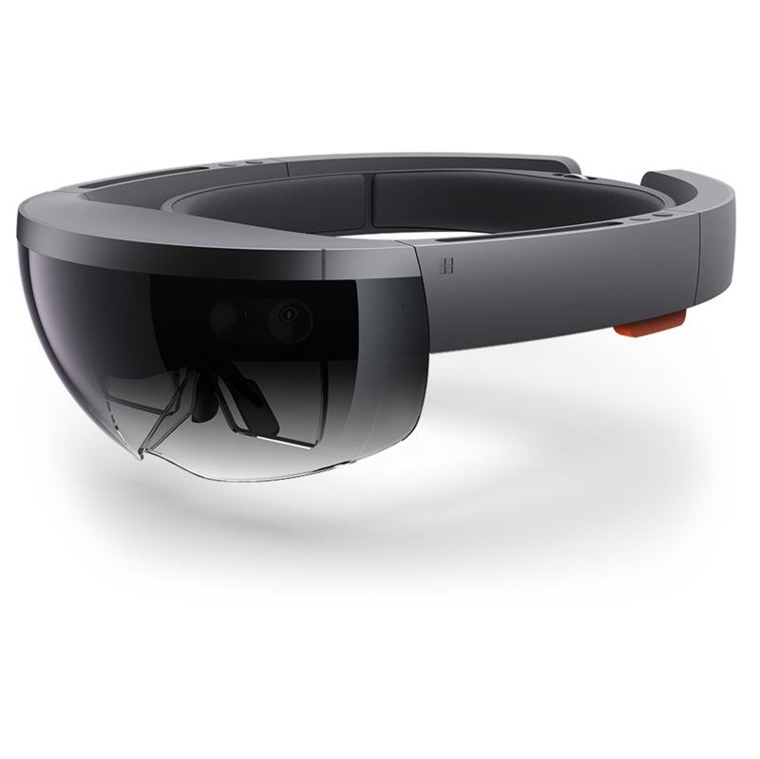
VR/AR & HoloLens
A futuristic vision of the age of holograms
https://www.ted.com/talks/alex_kipman_the_dawn_of_the_age_of_holograms

Slide 9

Cloud Computing & Research
A year ago at Virginia Tech researchers needed 2 weeks to analyze just 1 genome. Today, they can analyze 100 genomes each day.
Microsoft Azure for Research https://www.microsoft.com/en-us/research/academic-program/microsoft-azure-for-research/

Slide 10
Q&A
Alex.Krakovetskiy@devrain.com
@msugvnua

